Slide 1
SNP CALLING
From BAM to VCF
JOSE DE VEGA
jose.devega@earlham.ac.uk

Slide 2
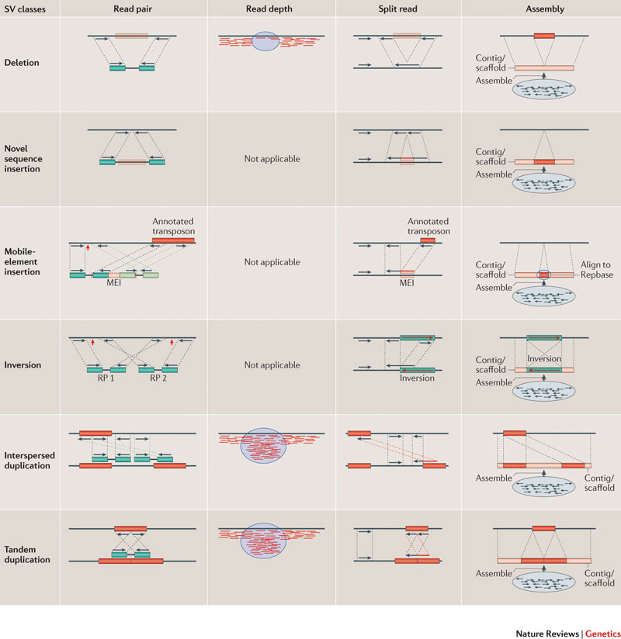
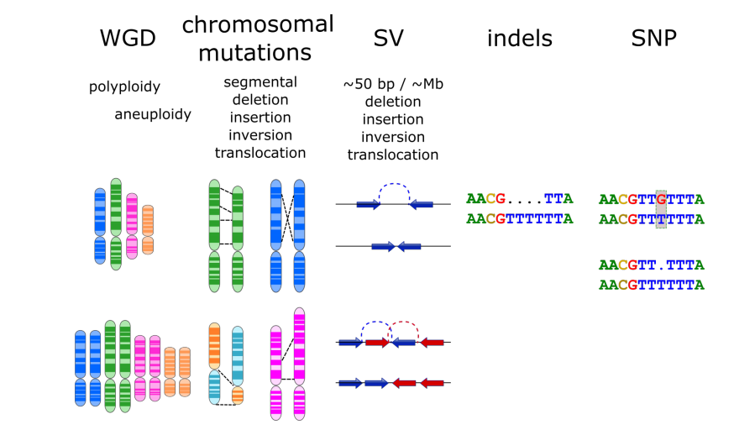

Types of genomic variation
Alkan et al. (2011) Nature Rev Genet 12: 363-376

Slide 3
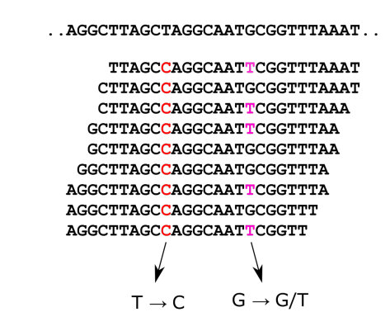
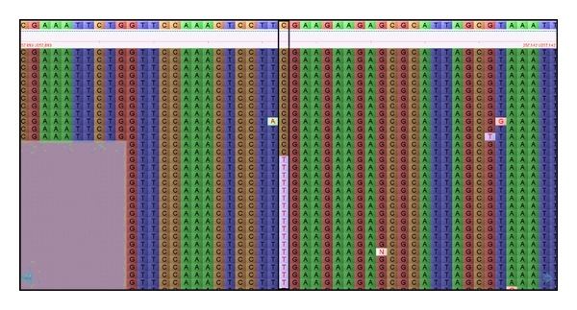
What is SNP calling?
Check for differences
Sequencing introduces errors
Rare alleles
Align reads to the reference
Reads are short (less every day)
Genomes are repetitive

Slide 4
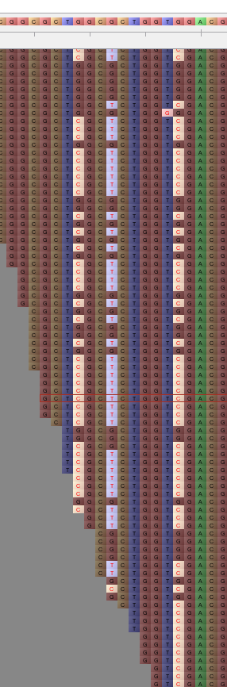
Sources of false positives (1 of 3): bad mapping
Reads mapped to somewhere other than their true origin (e.g. recently duplicated genes)
Accounts for approx. 40% of false positives
Symptoms:
locations are heterozygous
several of these very close together
two or more clearly distinguishable classes of reads with variants in phase
difficult to distinguish from genuine haplotypes
Remediation: good mapping tool with appropriate means of suppressing mis-mapping (e.g. Bowtie/Bowtie2)

Slide 5
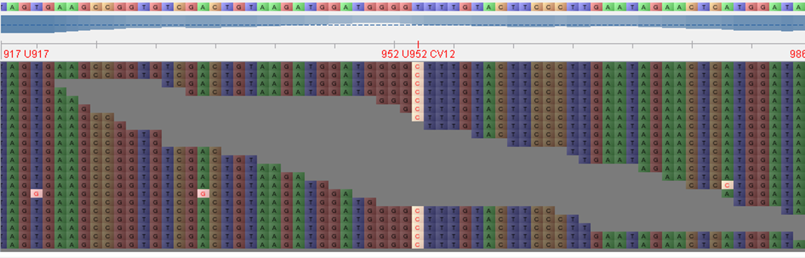
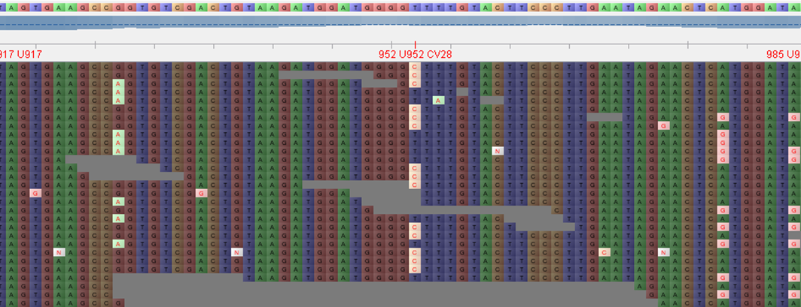
Sources of false positives (2 of 3): reference assembling errors
Symptoms:
With the strict mapping of single samples, some SNPs are apparently homozygous
In the relaxed mapping, reads appear with many mismatches that have the genome allele
Implies misassembly of the reference
Assembler has likely produced a faulty sequence from two set of reads from pairs of paralogs
Strict mapping
Relaxed mapping
Agnieszka Golicz
Antonio Ribeiro

Slide 6
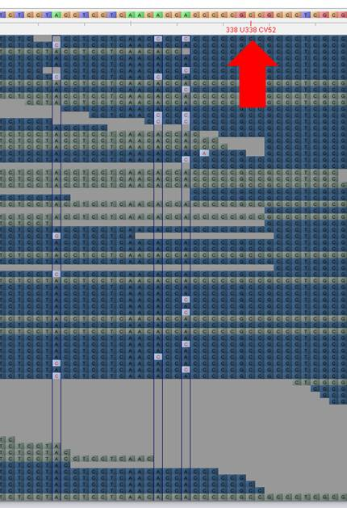
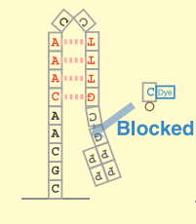
Sources of false positives (3/3): Illumina sequencing errors
Sequencing error in Illumina data in GGC motifs
GGC motifs inhibit DNA polymerase -- inverted repeats lead to folding of sequenced DNA strand
Both blocks base incorporation and leads to dephasing of signal in cluster

Slide 7
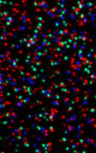
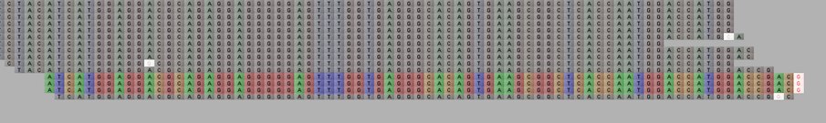
Sources of false positives (3/3): Illumina (minor) sequencing errors
Sequencer image analysis error: Multiple identical reads are called from what should be a single cluster in flow cell
Symptom: clusters of identical sequences with identical start/end positions and read error in same position across all reads
Remediation: remove identical duplicates (also remove PCR duplicates in WGS, but not in GBS/RADSeq)

Slide 8
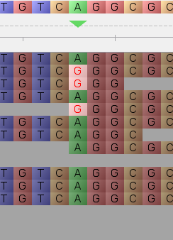
Coverage is key to reliable SNPs
Coverage = number of times a given region has been sequenced
In diploid or polyploid organisms, at low coverage, the risk of not sampling all chromosomes is high
To reliably call genotypes we need good coverage

Slide 9
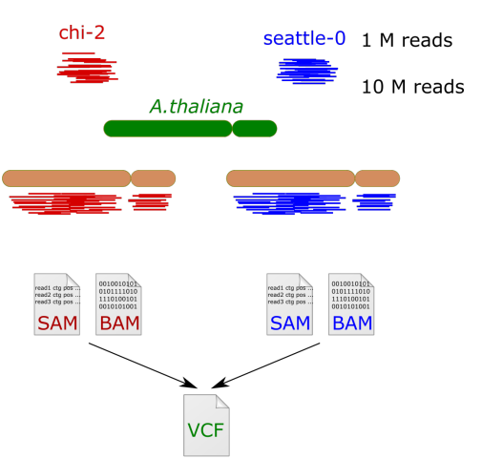
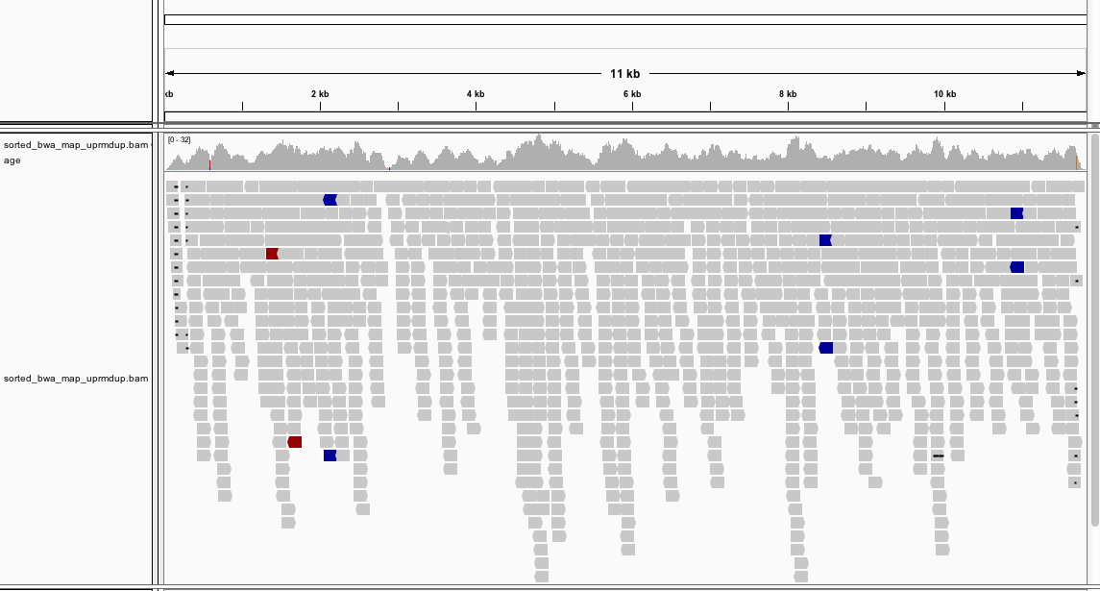
The basic workflow…
FASTQ
FASTQ

Slide 10
FASTQ file
4 lines per read
Stores sequence and quality
Read ID
@HWI-ST790:234:D0W8BACXX:1:1101:1792:2000 1:N:0:GCCAA
ACNATTAACAACCTTGGTGTTCAGCATGAGAACTTATCTGCAGCTGAGTCTCGTATCCGTGACG
+
CC#4ADDFHHHHHIIIIEGHIIIIIIIIIIGIIIIIIIIIIIIIIIIIDGHHIDHHIII6@FGI
@HWI-ST790:234:D0W8BACXX:1:1101:2592:1999 1:N:0:GCCAA
CTNGAATGCAGGTAGAATACATCTCCCGGATAAGCCTCGCGGCCCCCGGGGCGGGGGGGGAGAG
+
:=#44AA?:<DFFE>FED?3A<EHH>FIF?ADGCGBA?D#########################
@HWI-ST790:234:D0W8BACXX:1:1101:4221:1999 1:N:0:GCCAA
GGNAAATACGAAAGATAAGCTACGCAAGAAACGAAGGATTACTGCGAAAGGCTGCGATGCGGCA
+
@@#4=BDDFDFHDIIBGIHHHIGGIIIBHHIF=ABB@?B<DE@BF<FHH@@EHACD<B3=8@:B
Sequence
Quality

Slide 11
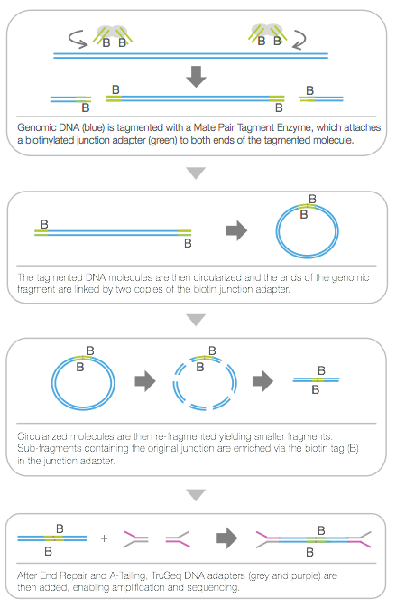
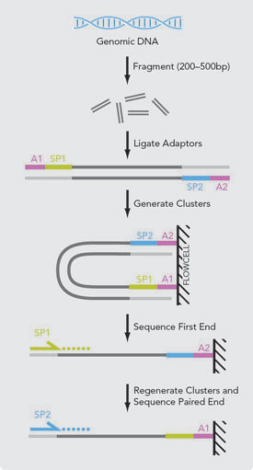
Paired reads

Slide 12
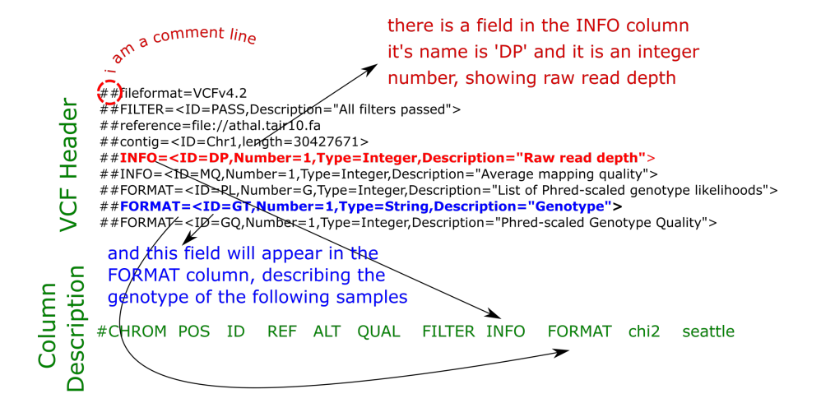

VCF file: Header and body

Slide 13
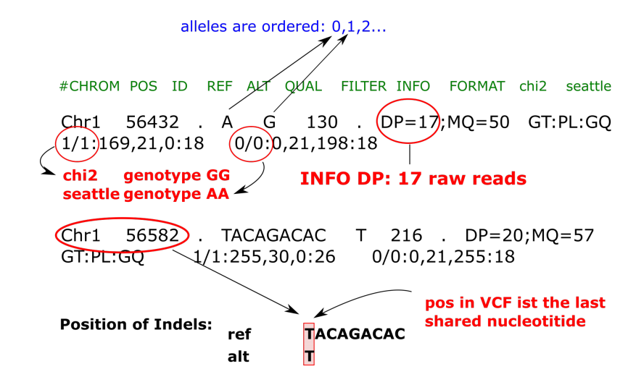
VCF file: Lines with “calls” in a position

Slide 14
A “real” Pipeline
Read preprocessing
Quality trimming (Q20) with Trimmomatic
Adapter removal
Read mapping
Bowtie2, Single best location only, max. sensitivity
1-3% mismatches allowed
Variant Discovery
--no-population-priors , --min-alternate-count 5 , --min-alternate-total 5 , --min-alternate-fraction 0.9, --min-mapping-quality 20, --min-base-quality 20, no secondary alignments
Variant Filtering
Map by sample, then merge BAM files with samtools
heterozygosity, QUAL, biallelic SNPS only, systematic sequencing error
subtraction of background SNPs (where appropriate)
Validation
where possible – requires benchmark data
Freebayes

Slide 15
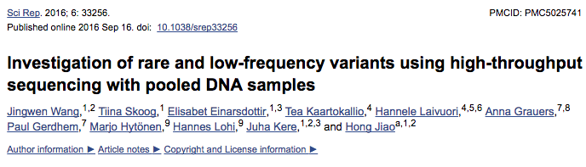
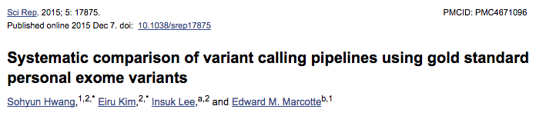
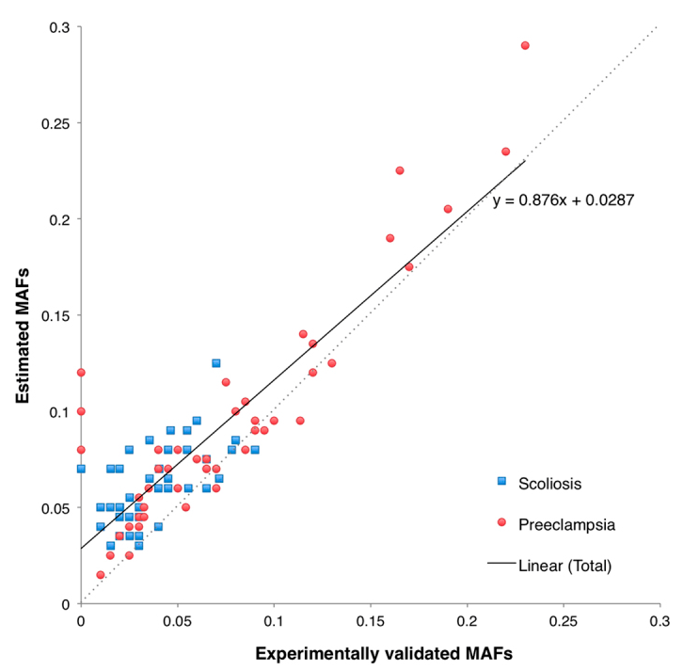
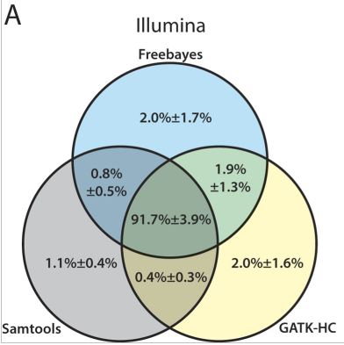
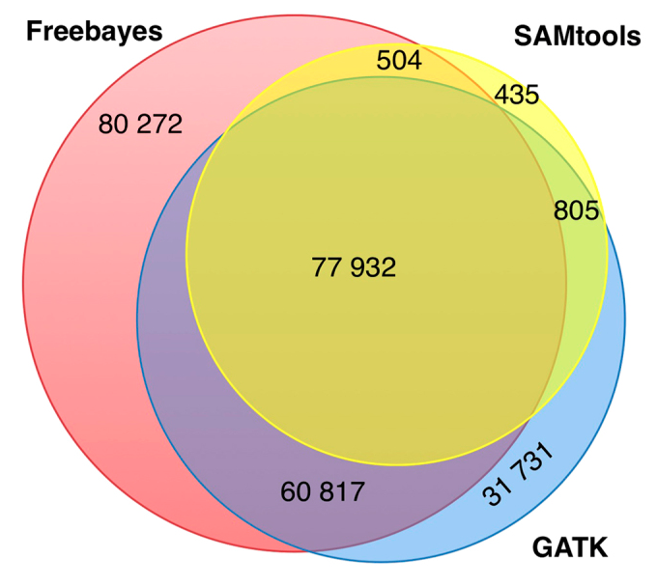
Some variant discovery discovery tools
GATK (http://www.broadinstitute.org/gsa/wiki/index.php/The_Genome_Analysis_Toolkit)
Focus in human genetics
Complex but accurate
samtools (http://samtools.sourceforge.net/samtools.shtml)
fairly basic, little configurability
FreeBayes (https://github.com/ekg/freebayes)
Can handle different ploidies and multiple samples
A bit “black box”

Slide 16
Filtering SNPs
Objective: separate genuine variants from sequencing errors or bioinformatics artefacts
Filtering parameters depend highly on your application!
Can be done during and/or after variant calling
Commonly used filters:
quality score
min/max number of reads at variant location (coverage depth)
number/fraction of reads with alternate allele
read mapping quality
base quality of the alternate alleles
secondary alignment filter
Filtering depends on whether or not flags are actually present in VCF file
example: PV4 field in VCF output is required for strand bias filtering but Freebayes does not output this
Variety of packages available for filtering
Some quite limited (samtools, vcftools)
Some fail to install on Ubuntu (vcflib)
Most people write their own code for filtering
vcflib works well with Freebayes
Filtering in spreadsheet programs is an option as long as the size of the dataset is supported

Slide 17
EXERCISE!
There is a detailed PDF guide in the data folder, summary:
Your alignments are done (bam file) and indexed (bai file)
Homework: You can use samtools view to check them
1st task: Run Freebayes on defaults:
On its simplest way of running, you just need to feed it with the alignments (sam file) and reference genome (fasta file), to obtain a list of SNPs (vcf file).
Open the resulting file (Eg. With the commands cat or less in the command line, or look for the folder and click on the new file ;)
2nd task: Check Freebayes advance options “freebayes --help”
Look for the option --min-alternate-count, which asks for at least 3 reads in one sample to call a variant in that position.
3rd taks: Postfiltering
Use vcf-annotate to require a min. quality of 30 (Q=20) and a min. coverage of 100 (d=100).
Retain only the SNPs tag as “PASS” by Freebayes in the seventh column (Eg awk or Excel)
If you have time: Change the thresholds, how does the number of SNPs change?
Try several times the commands (exactly as) in the PDF before accepting computer’s victory
Peer instruction works: ask and help your coursemates

